Slide 1
Lightweight & Explainable Encrypted Traffic Analysis
Edge-XAI Defense
The project introduces Edge-XAI Defense, a novel approach to securing network perimeters against advanced threats hidden within encrypted traffic. We combine machine learning with explainable AI to provide robust and transparent intrusion detection.
Course : Cryptography and Network Security
Faculty: BALASARASWATHI
Team: Kruthikha vishali K - 23BDS1105, Harishni A - 23BDS1070

Slide 2


Project Overview: The Core Concept
Our project delivers a practical solution for modern network security challenges. We focus on detecting sophisticated threats hidden within encrypted communications.
ML-based IDS for Encrypted Traffic
Key Innovation: Explainability Layer (XAI)
A Machine Learning-based Intrusion Detection System (IDS) specifically designed for encrypted traffic (HTTPS/TLS).
Unlike traditional "Black Box" AI, our system includes an Explainability Layer (XAI).
It detects malware hiding inside secure tunnels without decrypting the data, preserving privacy.
It tells the security analyst why a specific connection was blocked (e.g., "Blocked because Packet Size Variance > Threshold").

Slide 3
Background of the Problem
The increasing prevalence of encryption, while beneficial for privacy, has inadvertently created a blind spot for traditional security measures, allowing malicious actors to operate undetected.
The Encryption Paradox
The DPI Failure
Over 90% of modern web traffic is encrypted (HTTPS/TLS). While this protects user privacy, it provides a perfect hiding spot for malware Command & Control (C2) communication.
Traditional "Deep Packet Inspection" (DPI) cannot read encrypted payloads. Security systems are going blind; they can see the "envelope" but not the "letter" inside.

Slide 4
Problem Statement
Addressing the critical need for efficient, transparent, and privacy-preserving threat detection at the network edge.
The Core Question:
"How can we accurately detect malicious patterns within encrypted network traffic on resource-constrained Edge devices without decrypting the data, while simultaneously providing human-readable explanations for every security alert?"
Key Challenges:
Our Solution:
Privacy: Detection must happen without decryption.
Efficiency: Must run on low-power hardware.
Trust: The AI must explain its decisions (XAI).
We use Lightweight Algorithms (XGBoost) optimized for CPU performance.
This allows the defense system to run directly on Edge devices (routers/firewalls) rather than cloud servers.
Modern Deep Learning models are too heavy for standard home routers or IoT gateways. We cannot rely on expensive GPUs for real-time traffic analysis.

Slide 5

Related Works I: Deep Learning Approaches
Exploring the state-of-the-art in encrypted traffic analysis, highlighting the strengths and limitations of current deep learning models.
1
2
Elshewey & Osman (2025)
Cui et al. (2023)
Proposed Stacked Deep Ensemble models for HTTPS classification, demonstrating high accuracy in identifying encrypted threats.
Introduced "CBSeq" using channel-level behavior sequences for malware detection, focusing on the temporal aspects of traffic.
Limitation:
Computational Inefficiency: State-of-the-art Deep Ensembles and behavior sequence models (like CBSeq) require GPU-level resources, making them incompatible with the limited CPU/RAM of home routers or IoT gateways.
Packet Processing Latency: The depth of these neural networks introduces significant "per-packet" delay, which can lead to network bottlenecks or dropped connections in high-speed, real-time traffic environments.
The "Black Box" Problem: While models like those from Elshewey & Osman (2025) achieve high accuracy, they lack transparency, meaning a security admin cannot verify why a connection was flagged as malicious.
Domain Sensitivity: Many DL models are over-trained on specific datasets (like CIC-IDS2017) and struggle to maintain accuracy when faced with new, evolving encryption protocols not present in the training data.

Slide 6

Related Works II: The Explainability Gap
Examining the emerging field of Explainable AI (XAI) in cybersecurity and identifying where current research falls short.
XAI in Security Research
Hybrid Model Explanations
Singh et al. (2025) & Zeleke et al. (2025): Demonstrated the use of SHAP (SHapley Additive exPlanations) for anomaly detection, offering insights into model decisions.
Sharma & Lashkari (2025): Explored attention mechanisms for hybrid models, enhancing the interpretability of complex network traffic classifications.
However, there remains a significant gap between high-performance detection and granular, actionable explanations at the edge.
The Gap:
Post-hoc Complexity: Current XAI methods (like SHAP) are often applied to complex models after training, which adds a second, heavy layer of computation that can overwhelm Edge devices during traffic spikes.
Actionability Gap: Existing research often provides mathematical explanations (SHAP values) that are too abstract for human analysts to use for immediate, manual policy enforcement.
Feature-Level Redundancy: Most XAI studies analyze 80+ features, many of which are redundant; this wastes memory and makes the resulting "explanations" unnecessarily cluttered and hard to interpret.
Static Explanation Limits: Most current frameworks provide a single snapshot of an alert but fail to explain the temporal "story" of an attack as it progresses through different encrypted phases.

Slide 7

Identification of Research Gap
Our project specifically targets the critical voids in current encrypted traffic analysis, pushing the boundaries of what's possible at the network edge.
The "Efficiency" Gap
The "Specific" Explainability Gap
Feature Redundancy
Existing Deep Learning solutions are too heavy for routers. We need a model that operates efficiently on minimal statistical features, ideal for resource-constrained environments.
Most studies use full feature sets (80+ columns), leading to unnecessary computational overhead. We implement "Golden Feature" selection to reduce memory usage, crucial for IoT environments.
Current XAI implementations are often broad. We aim to provide packet-level explanations, detailing precisely why a specific flow duration, for instance, indicates a botnet activity.

Slide 8
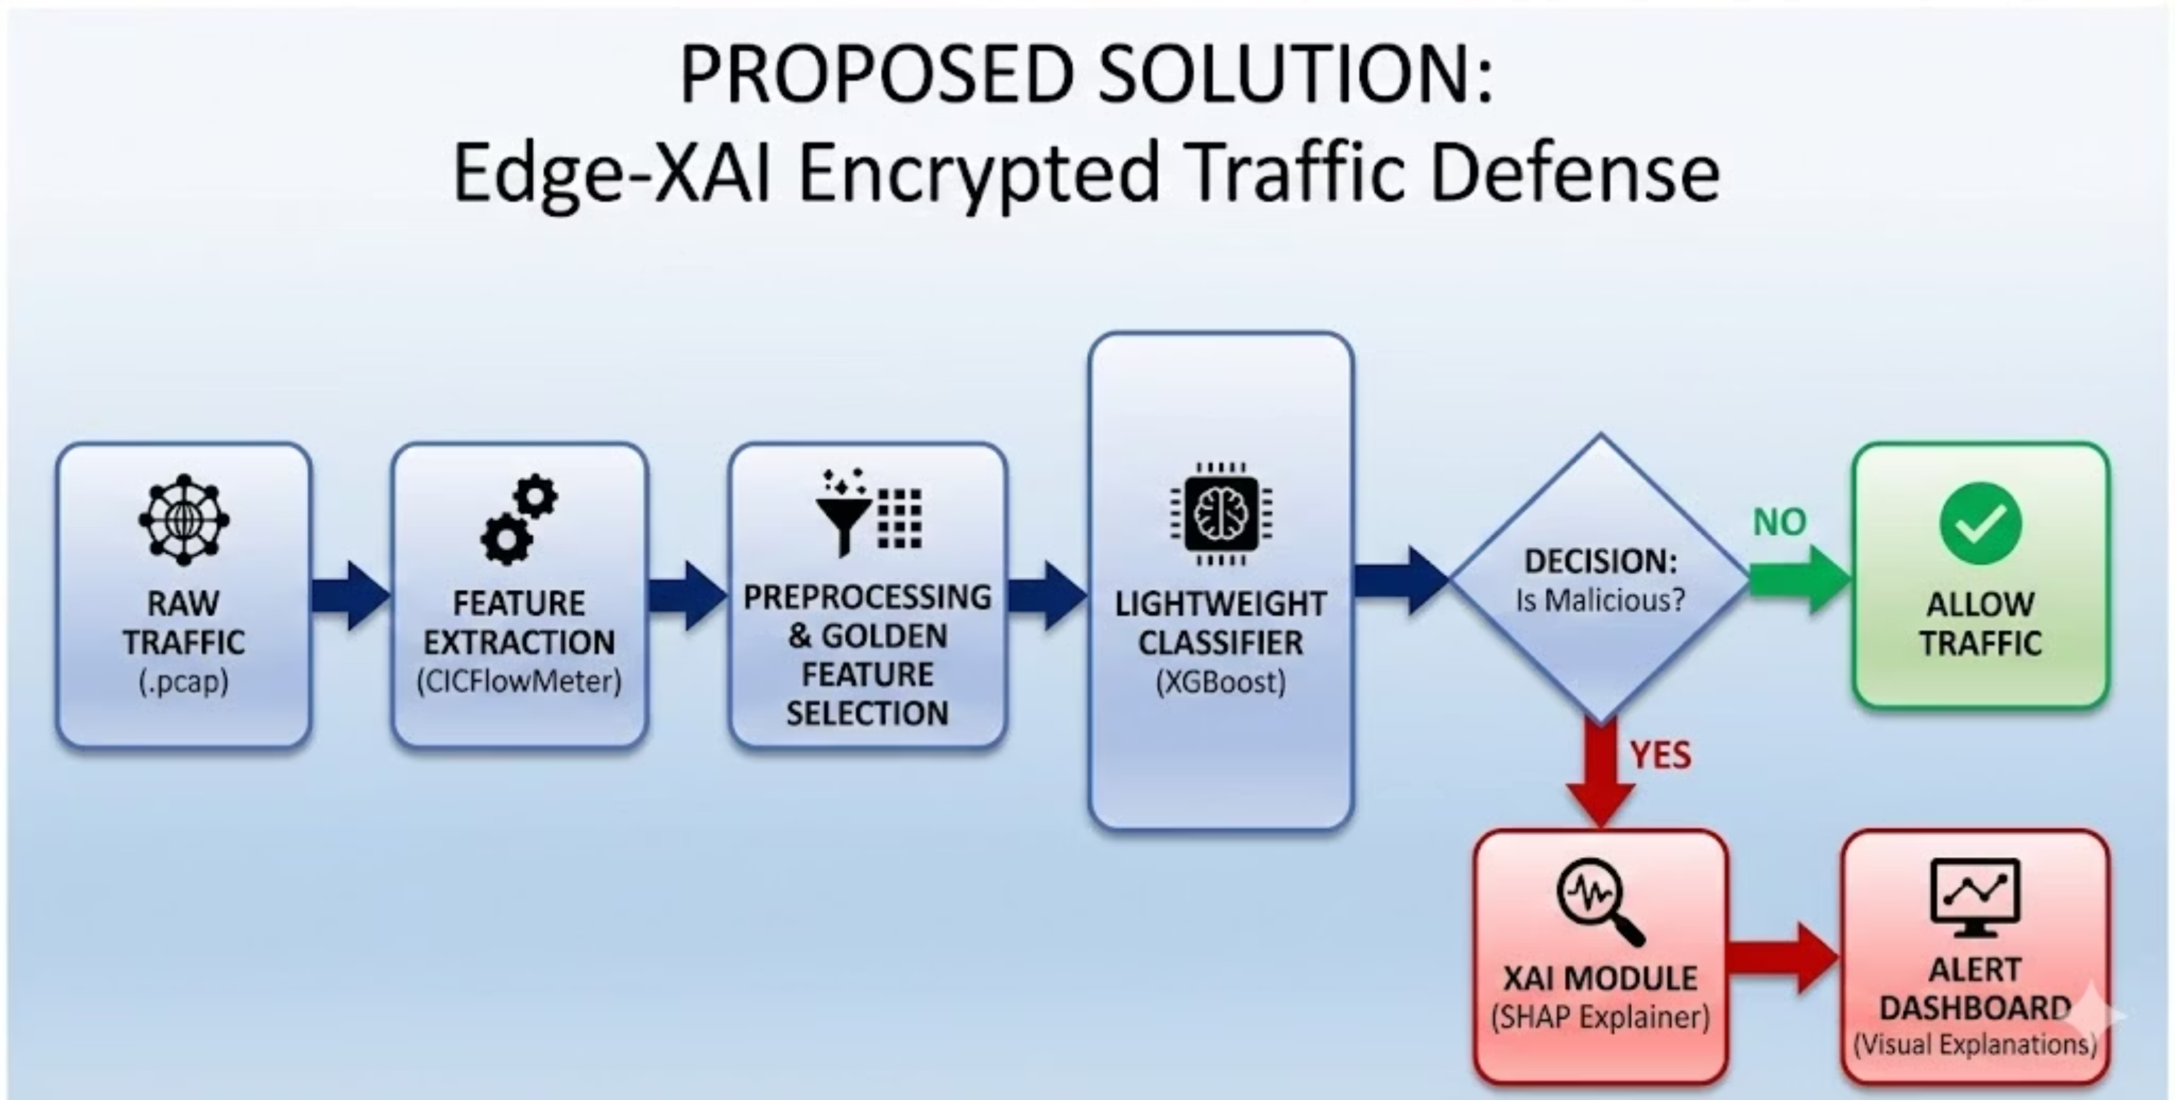
Proposed Solution: Block Diagram

Slide 9
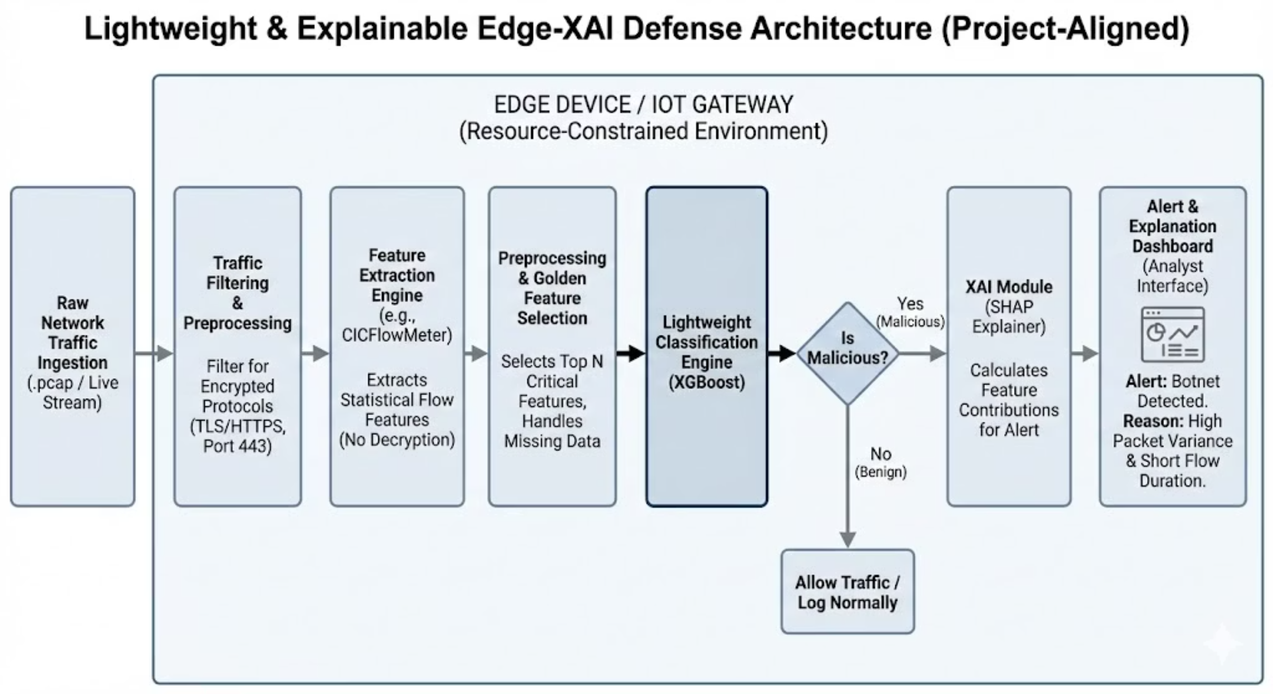
System Architecture

Slide 10
System Architecture
01
02
Ingestion
Statistical Extraction
The system captures raw packets and filters for Port 443 (HTTPS) to focus strictly on encrypted data, ensuring relevant traffic is analyzed.
Instead of reading the content (which is scrambled), we analyze the behavior—packet timing, size, and inter-arrival times to infer patterns.
03
04
The "Brain" (XGBoost)
The "Why" (SHAP)
A gradient-boosted decision tree analyzes these statistics to classify the connection as Benign or Malware with high accuracy and speed.
If malware is found, SHAP calculates the contribution of each feature, telling the analyst exactly which behavior triggered the alarm, providing critical context.

Slide 11
List of Modules I: Data Processing
The initial phase of our system focuses on robust and efficient data handling, transforming raw network traffic into a usable format for analysis.
1
2
3
Module 1: Data Ingestion & Filtering
Module 2: Feature Extraction (CICFlowMeter)
Module 3: Preprocessing & Cleaning
Capturing live or stored traffic (.pcap files) and meticulously filtering specifically for TCP/TLS protocols to ensure focus on encrypted data streams.
Converting raw packets into a structured CSV format, extracting over 80 statistical features such as Flow Duration and Flow Bytes/s, crucial for behavioral analysis.
Essential steps involving handling Infinity/NaN values—common anomalies in network data—and performing Label Encoding for multi-class target variables to prepare data for ML models.

Slide 12
List of Modules II: Detection & Analysis
This phase encompasses the core intelligence of our system, from identifying critical features to classifying threats and providing actionable explanations.
1
2
3
Module 4: Feature Selection (The "Golden" Set)
Module 5: Lightweight Classification Engine
Module 6: Explainability Interface (XAI)
Implementation of XGBoost, a highly efficient gradient-boosting framework. Includes rigorous hyperparameter tuning to meet "Edge" constraints, focusing on low depth and high speed.
Generating informative Force Plots and Summary Plots via SHAP to visualize the contributions of each feature to the model's decision, enabling clear decision path validation for security analysts.
Utilizing Correlation Matrix and Random Forest importance to pinpoint and select the top 20 most critical features, optimizing for memory usage and model efficiency in IoT environments.

Slide 13


Methodology – The Algorithm
Why XGBoost?
Why SHAP (SHapley Additive exPlanations)?
Speed: Parallel processing makes it 10x faster than traditional Gradient Boosting.
Efficiency: Handles sparse data (zeros) effectively, which is common in network flows.
It comes from Game Theory.
It treats each feature (e.g., Packet Size) as a "player" in a game and calculates how much that player contributed to the "winning" score (Malware Detection).

Slide 14



Expected Outcomes
Accuracy
Low Latency
Transparency & Explainability
Target detection accuracy of >95% on the CIC-IDS2017 dataset.
Inference time under 10ms per flow, ensuring real-time capability.
A fully functional dashboard where every alert is accompanied by a visual explanation (e.g., "This flow was blocked because the Backward Packet Length was anomalously high").

Slide 15
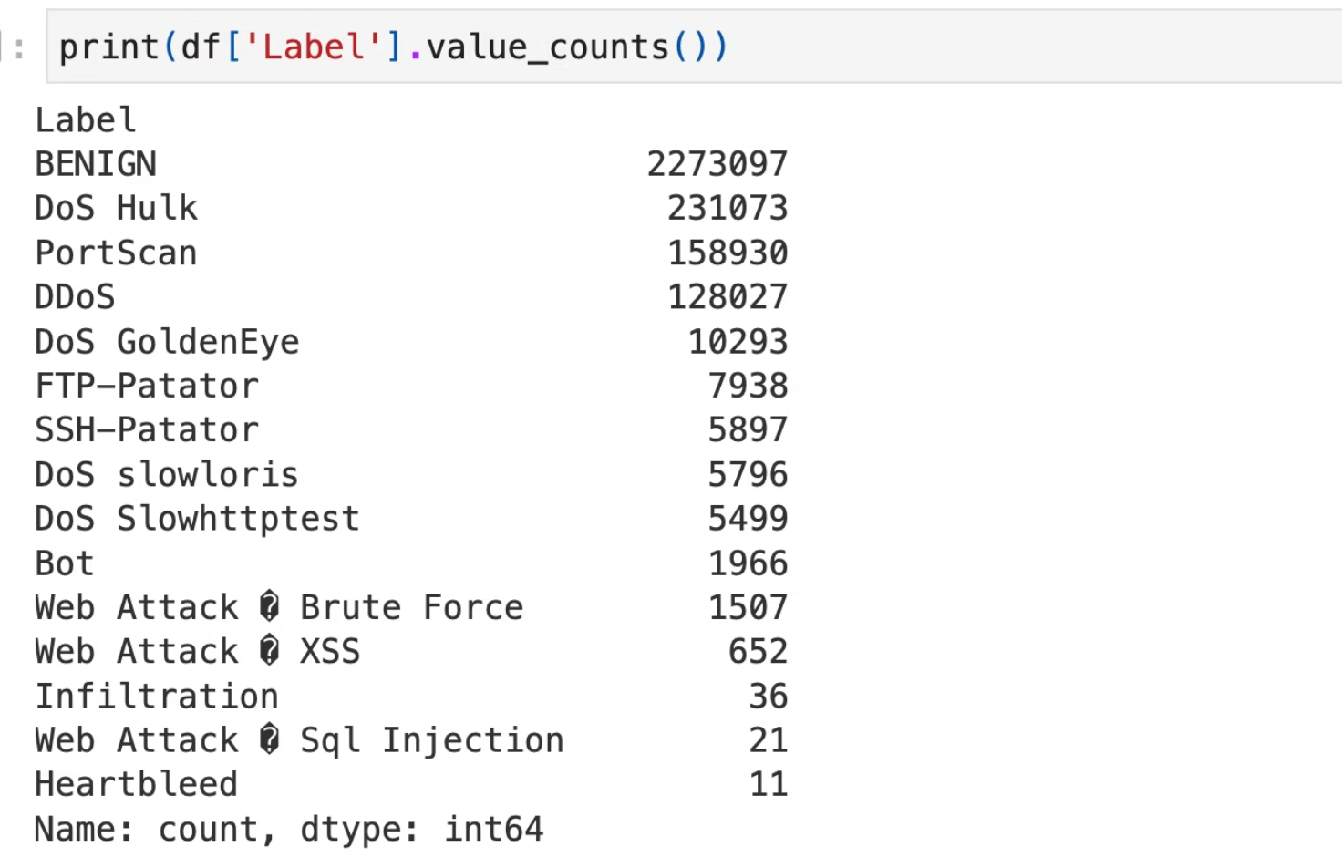
IMPLEMENTATION:
Phase 1 & 2 – Data Ingestion & Hygiene - Foundation: Processing the CIC-IDS2017 Dataset
Dataset Scope: Merged 8 raw CSV files encompassing 2,830,743 rows of network flow data.
Feature Engineering: Extracted 79 initial statistical features (IAT, Packet Lengths, Flags).
Aggressive Data Cleaning: * Identified and removed 101 NaN and 665 Infinite values caused by network division-by-zero anomalies
  Total rows removed for data integrity: 2,867.
Label Encoding: Converted multi-class attacks (DoS, PortScan, Bot, etc.) into a lightweight Binary Classification (0: Benign, 1: Malicious) for Edge efficiency.

Slide 16



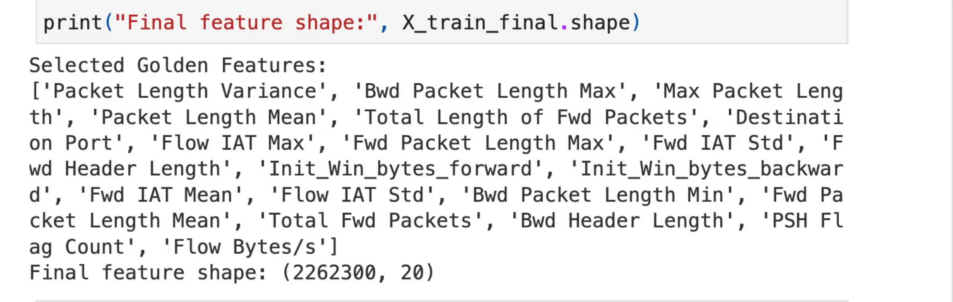
Phase 3 – The 'Honest' Optimization
Eliminating Data Leakage for Ethical AI
The "Honest" Correction
Dimensionality Reduction
Final Feature Shape
Initial analysis showed Destination Port was over-contributing to model decisions. The critical fix was dropping Destination Port and Dst Port to prevent the model from memorizing ports rather than learning traffic patterns.
Correlation Pruning: Dropped 23 redundant features with >0.95 correlation
Golden Feature Selection: Used Random Forest importance to isolate the Top 20 predictive features
Dataset reduced from 77 to 20 columns, drastically reducing memory overhead for Edge devices.
Random Forest Feature Importance List

Slide 17
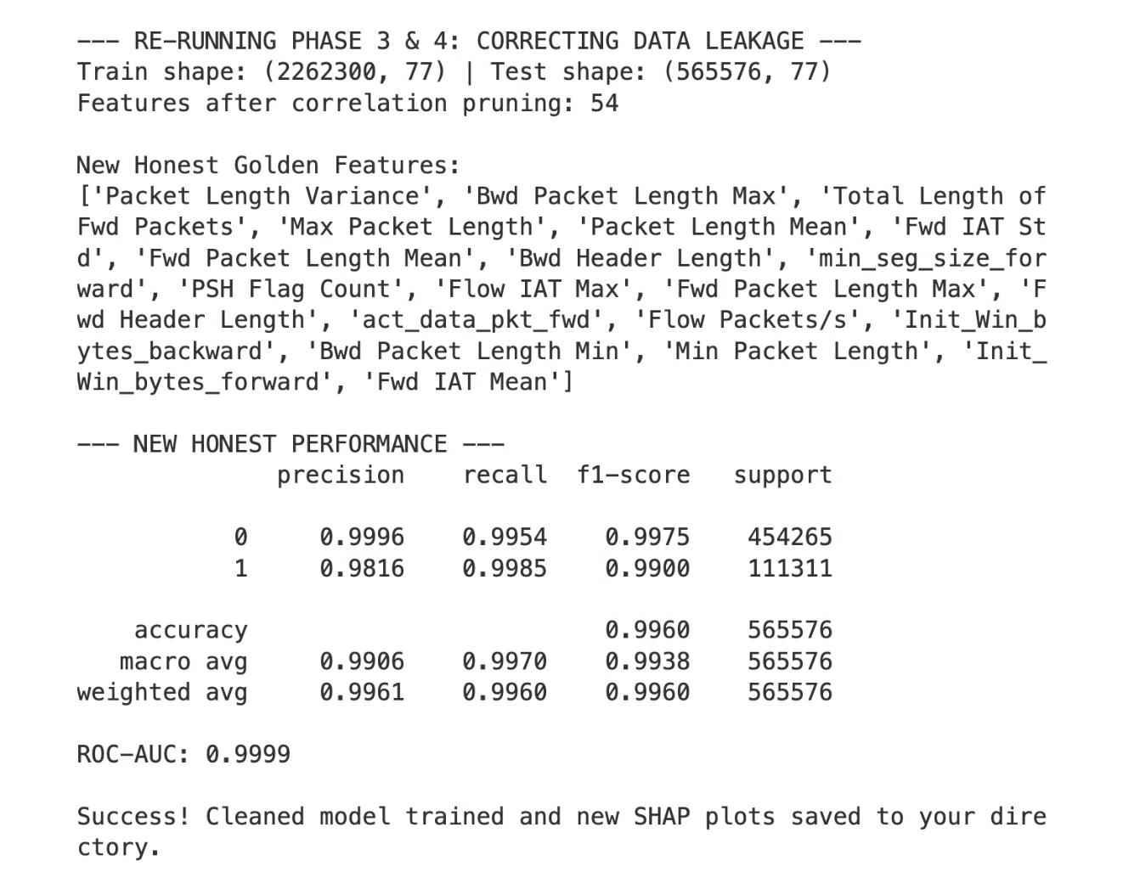



Phase 3 & 6 – Lightweight Engine & Performance
Real-Time Detection at the Edge
Classification Engine
Honest Model Performance
Deployed an XGBoost Classifier with shallow trees (max_depth=4) to maximize execution speed.
Accuracy: 99.60%
Detection (Recall): 99.85%
ROC-AUC: 0.9999
Latency Verification
Inference Time: 1.3068 ms
Result: Beats the <10ms requirement, proving real-time capability.

Slide 18

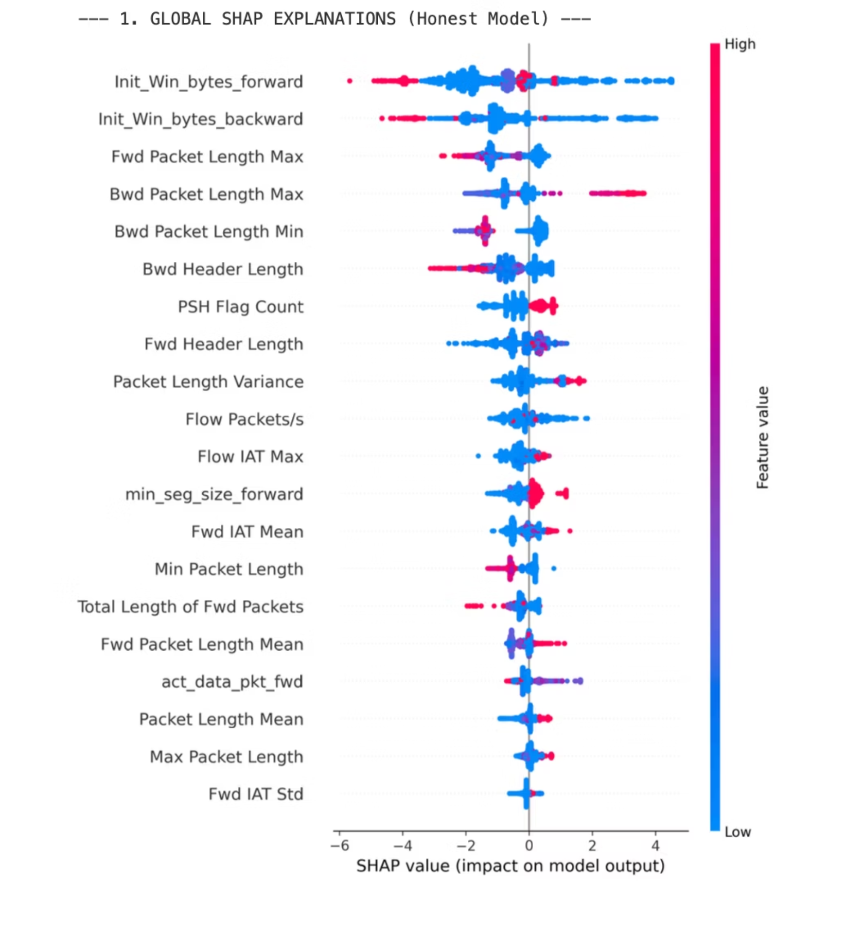



Phase 4 – Global Explainability (XAI)
Global Transparency: What the Model Learned
SHAP Integration
Used SHAP TreeExplainer to decode the "Black Box" XGBoost ensemble.
Top Contributors
Identified Initial Window Bytes (Forward/Backward) and Packet Length Max as the most critical indicators of malicious encrypted traffic.
Feature Value Impact
High Initial Window Bytes significantly pushes the model toward a "Malicious" alert.
Packet Length Variance serves as a key statistical signature for automated attack patterns
SHAP Beeswarm Plot

Slide 19
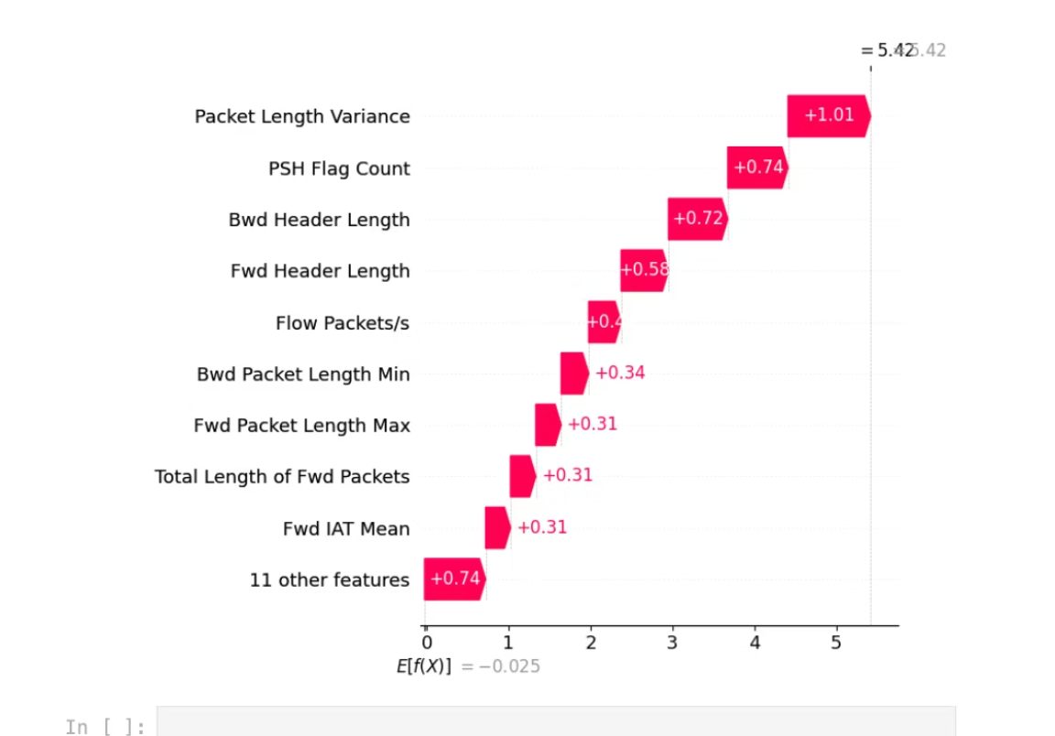
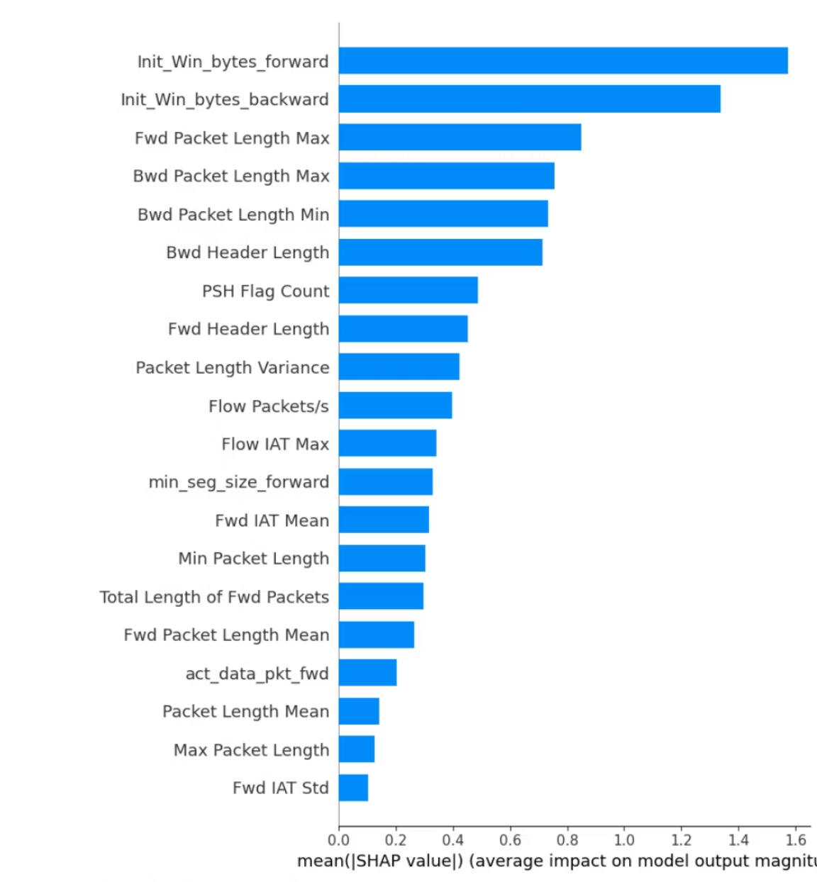
Phase 5 – Local Explainability (XAI)
SHAP Waterfall Plot: Instance-Level Predictions
While global explainability shows overall model behavior, local explainability reveals how the model makes decisions for individual predictions.
Mean SHAP Values (Feature Importance)
SHAP Waterfall Plot

Slide 20






Explainable AI (XAI) – Decoding Model Decisions
Transforming Security Alerts into Actionable Intelligence
Global Feature Importance (Global Impact)
Local Case Study: Malicious Flow Analysis
Dominant Indicators
Protocol-Agnostic Learning
The "Why" Behind an Alert
Key Attack Signatures
The model identifies Initial Window Bytes (Forward and Backward) as the primary drivers of its decision-making process.
Packet Length Variance (+1.01): The single largest contributor, indicating automated, non-human traffic patterns.
PSH Flag Count (+0.74): Highlights high-frequency data pushing, typical of DDoS or data exfiltration.
Header Length Dynamics (+0.72): Abnormal header sizes further pushed the model toward a "Malicious" classification.
By focusing on statistical flow headers (e.g., Packet Length Max and Header Length) rather than payloads, the model effectively analyzes encrypted traffic without decryption.
For a sample malicious flow (Prediction: 5.42), the system provides a clear mathematical justification against its base probability.
Edge Reliability
Global patterns show that the model relies on hardware-verifiable metrics like Flow Packets/s and Packet Length Variance, ensuring robust performance on IoT gateways.
Analyst Transparency
This waterfall visualization allows a network administrator to verify that the block was based on traffic physics, not random noise.

Slide 21



Future Implementation & Comparative Analysis
Path to Deployment: Live Dashboard & Research Benchmarking
Phase 5: Decision Support System (DSS) Integration
Phase 6: "Edge vs. Cloud" Benchmarking
Phase 7: Manuscript & IEEE Publication
Prototyping: Developing a live Streamlit-based dashboard to simulate real-time edge traffic analysis.
Interactive XAI: Implementing a user interface where security analysts can view SHAP Waterfall plots for every high-risk alert, translating raw model scores into actionable insights.
Theme: "Edge vs. Cloud Defense: A Comparative Framework for Encrypted Traffic Analysis."
Core Contribution: Proving that "Honest" feature engineering (omitting protocol-specific ports) creates a payload-agnostic model capable of securing encrypted TLS traffic.
Performance Parity: Validating that our optimized XGBoost matches the F1-Score of heavy Deep Learning models (0.9938).
The "Edge Win": Quantifying our ~1.3ms inference latency advantage over Cloud-based Deep Learning architectures.
Efficiency Metrics: Comparing model file sizes and memory footprints to prove suitability for IoT gateways.

Slide 22
References
K. Singh, A. Kashyap, and A. K. Cherukuri, "Interpretable Anomaly Detection in Encrypted Traffic Using SHAP with Machine Learning Models," arXiv preprint arXiv:2505.16261, 2025.
S. N. Zeleke, A. F. Jember, and M. Bochicchio, "Integrating explainable AI for effective malware detection in encrypted network traffic," arXiv preprint arXiv:2501.05387, 2025.
S. Cui, C. Dong, M. Shen, Y. Liu, B. Jiang, and Z. Lu, "CBSeq: A channel-level behavior sequence for encrypted malware traffic detection," IEEE Transactions on Information Forensics and Security, vol. 18, pp. 5011-5025, 2023.
A. Sharma and A. H. Lashkari, "Hybrid attention-enhanced explainable model for encrypted traffic detection and classification," International Journal of Information Security, vol. 24, p. 144, 2025.
A. M. Elshewey and A. M. Osman, "Enhancing encrypted HTTPS traffic classification based on stacked deep ensembles models," Scientific Reports, vol. 15, no. 35230, 2025.

Slide 23
References
Y. Hu, K. Xiao, L. Luo, and L. Chen, "An XGBoost-Based Intrusion Detection Framework with Interpretability Analysis for IoT Networks," Applied Sciences, vol. 16, no. 2, p. 980, 2026.
I. A. Alwhbi, C. C. Zou, and R. N. Alharbi, "Encrypted network traffic analysis and classification utilizing machine learning," Sensors, vol. 24, no. 11, p. 3509, 2024.
R. T. Elmaghraby, N. M. A. Aziem, M. A. Sobh, and A. M. Bahaa-Eldin, "Encrypted network traffic classification based on machine learning," Ain Shams Engineering Journal, vol. 15, no. 2, p. 102361, 2024.
F. Alserhani, "Analysis of Encrypted Network Traffic for Enhancing Cyber-security in Dynamic Environments," Applied Artificial Intelligence, vol. 38, no. 1, 2024.
Y. Sharma, S. Birnbach, and I. Martinovic, "RADAR: A TTP-based extensible, explainable, and effective system for network traffic analysis and malware detection," in Proceedings of the 2023 European Interdisciplinary Cybersecurity Conference, pp. 159-166, June 2023.

